Slide 1
Project Description: College Libraries Directory Management System
Is a Desktop Application created using visual studio.
The desktop application which is created to store the all details related to libraries and librarians of Mumbai University using very user friendly environment.
The application is consist of total eight forms plus login form and Main form.
Application is connected to SQL SERVER database by creating database in SQL SERVER.

Slide 2
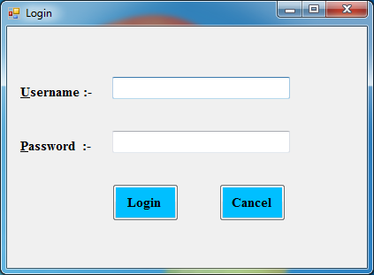
1} Login Page

Slide 3
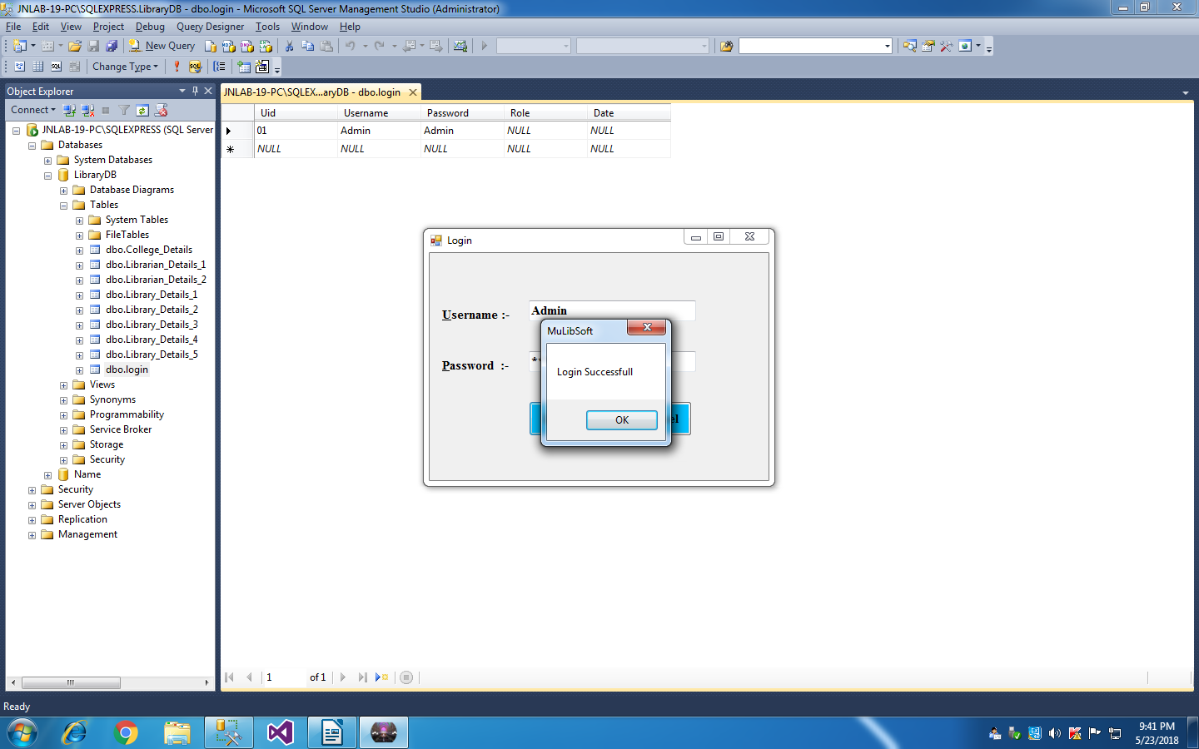

Slide 4
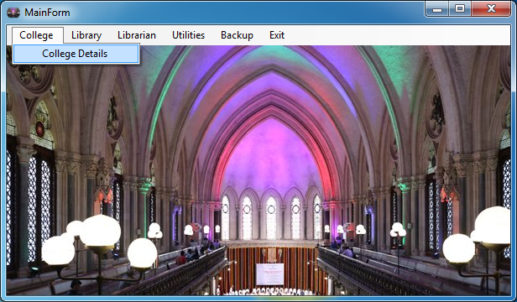
2} Main Form:
Added ToolStripMenuItem.

Slide 5
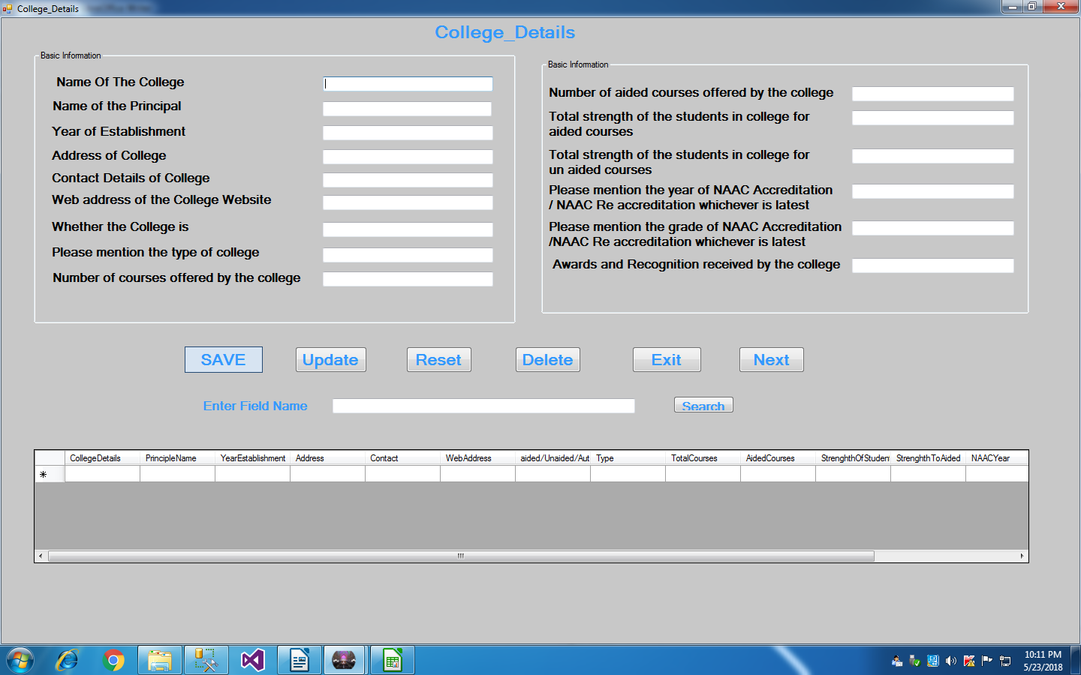
3} College_Details:

Slide 6
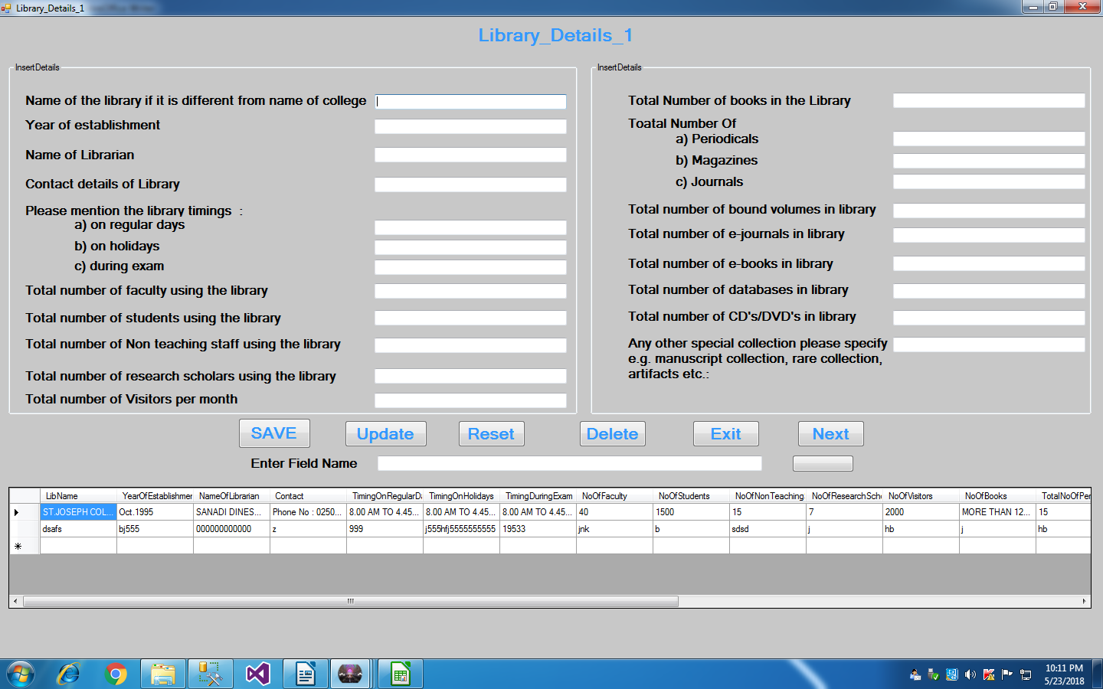
4} Library_Details_1:

Slide 7
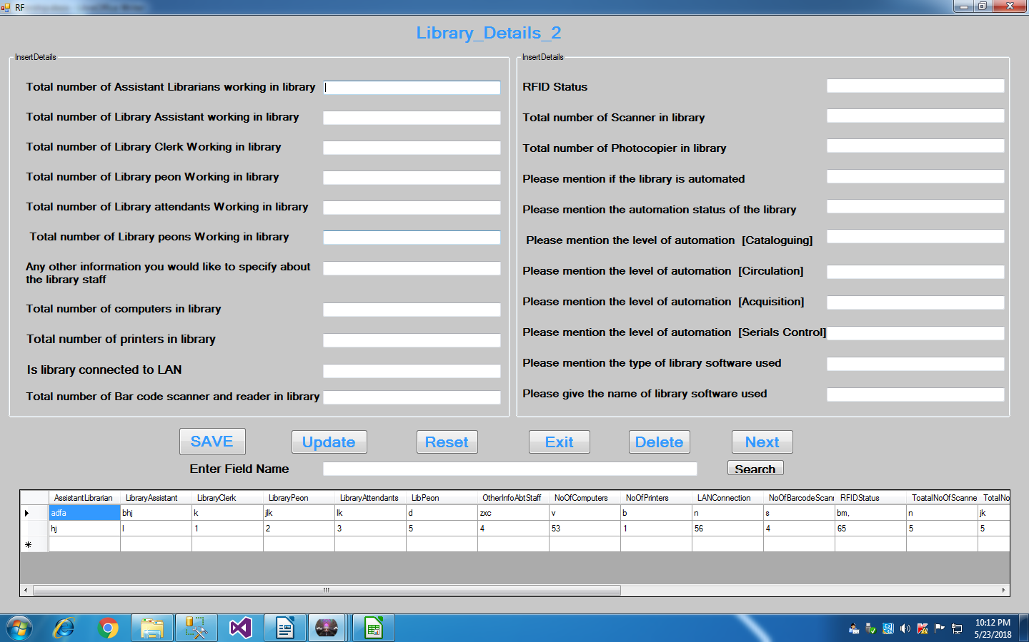
5} Library_Details_2:

Slide 8
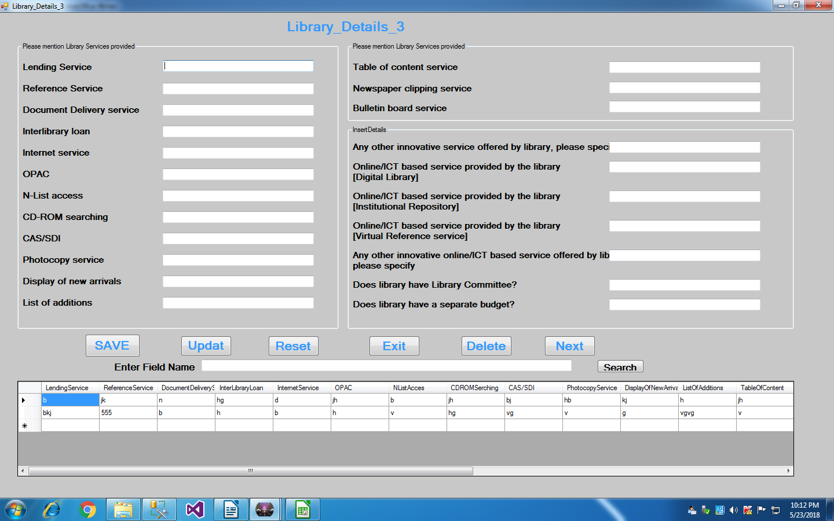
6} Library_Details_3:

Slide 9
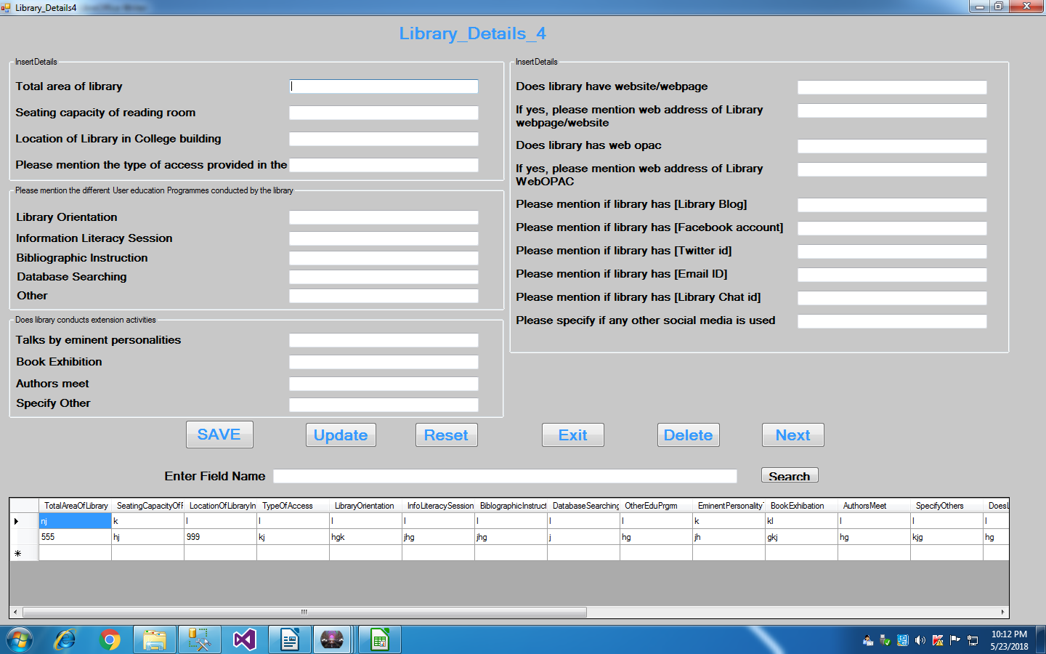
7} Library_Details_4:

Slide 10
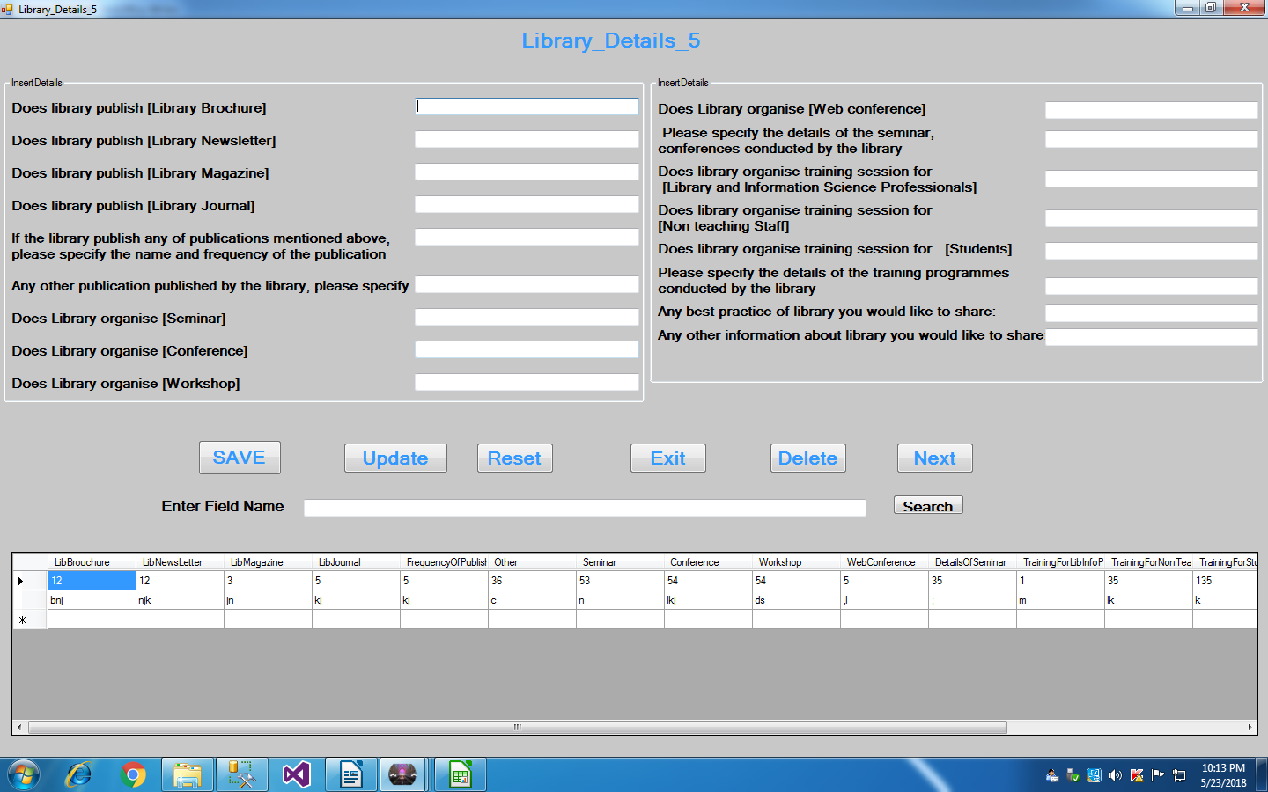
8} Library_Details_5:

Slide 11
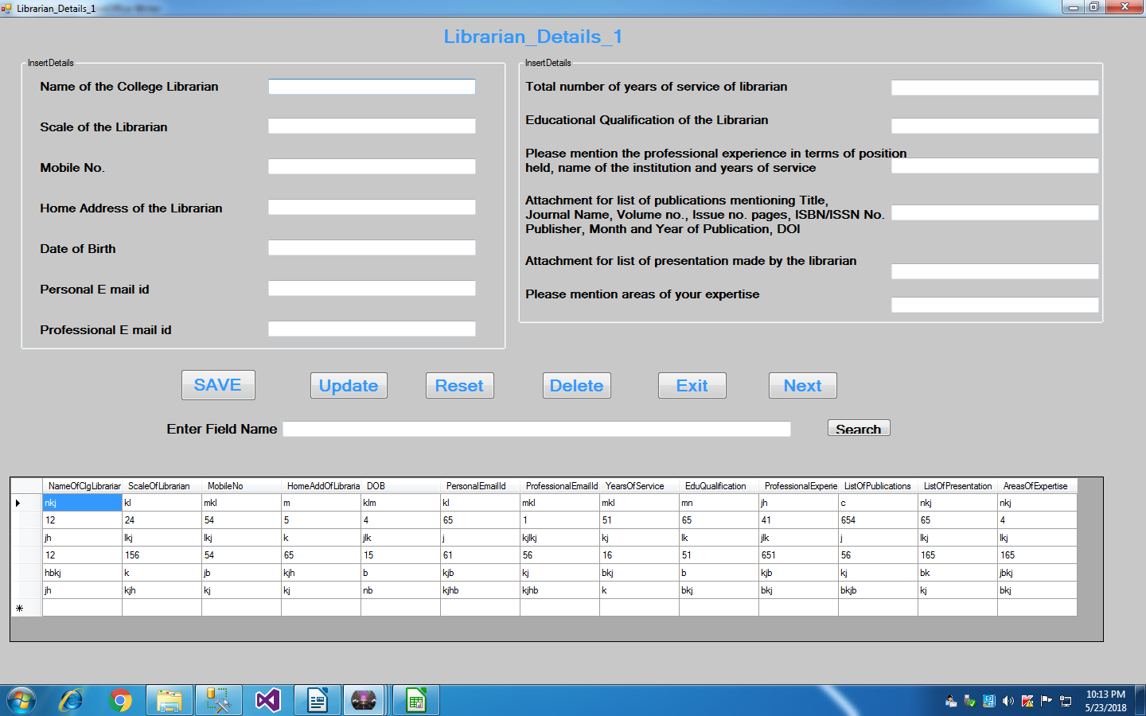
9} Librarian_Details_1:

Slide 12
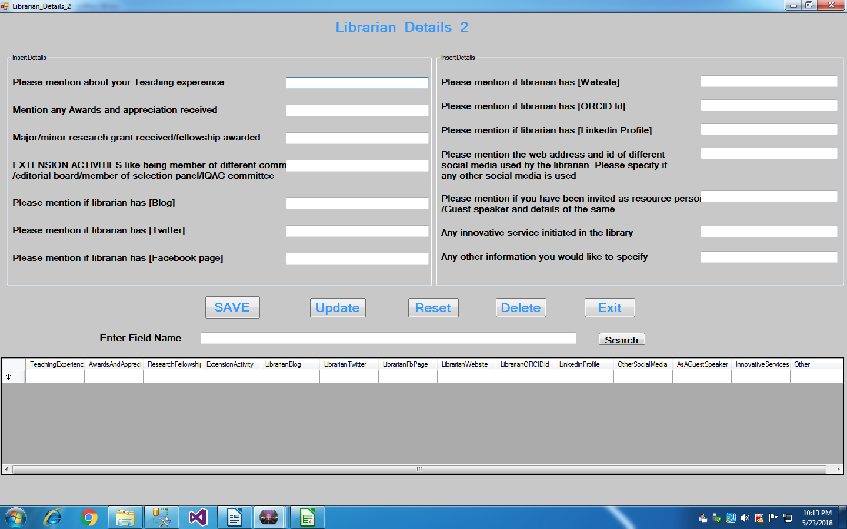
10} Librarian_Details_2:

Slide 13
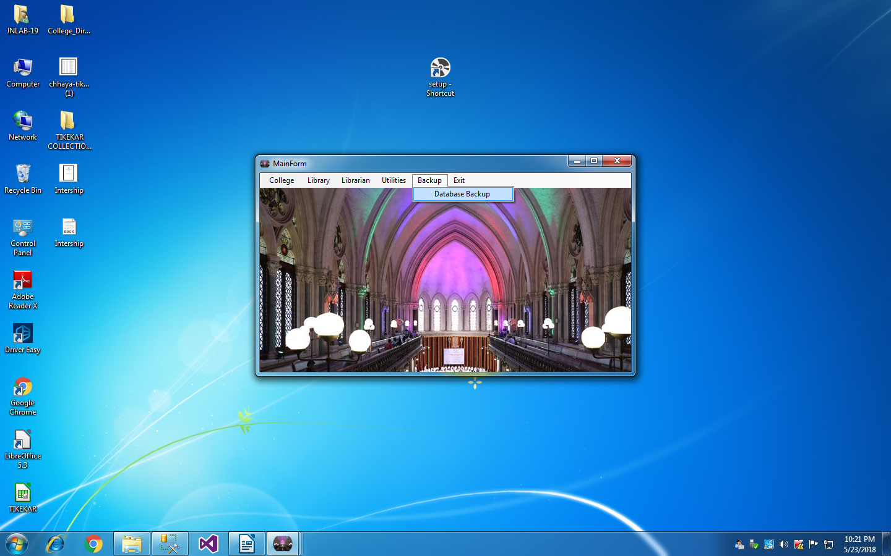
11} Database_backup:

Slide 14
Functionality:
Various functionalities added to models. Like saving information to database, delete from database, update to database, Reset, Grid view to see stored database, search option textbox which search information from database and show in data grid view, Next button to visit next form, exit button to exit. This all functionalities help in creating proper management of libraries and librarians details.

Slide 15
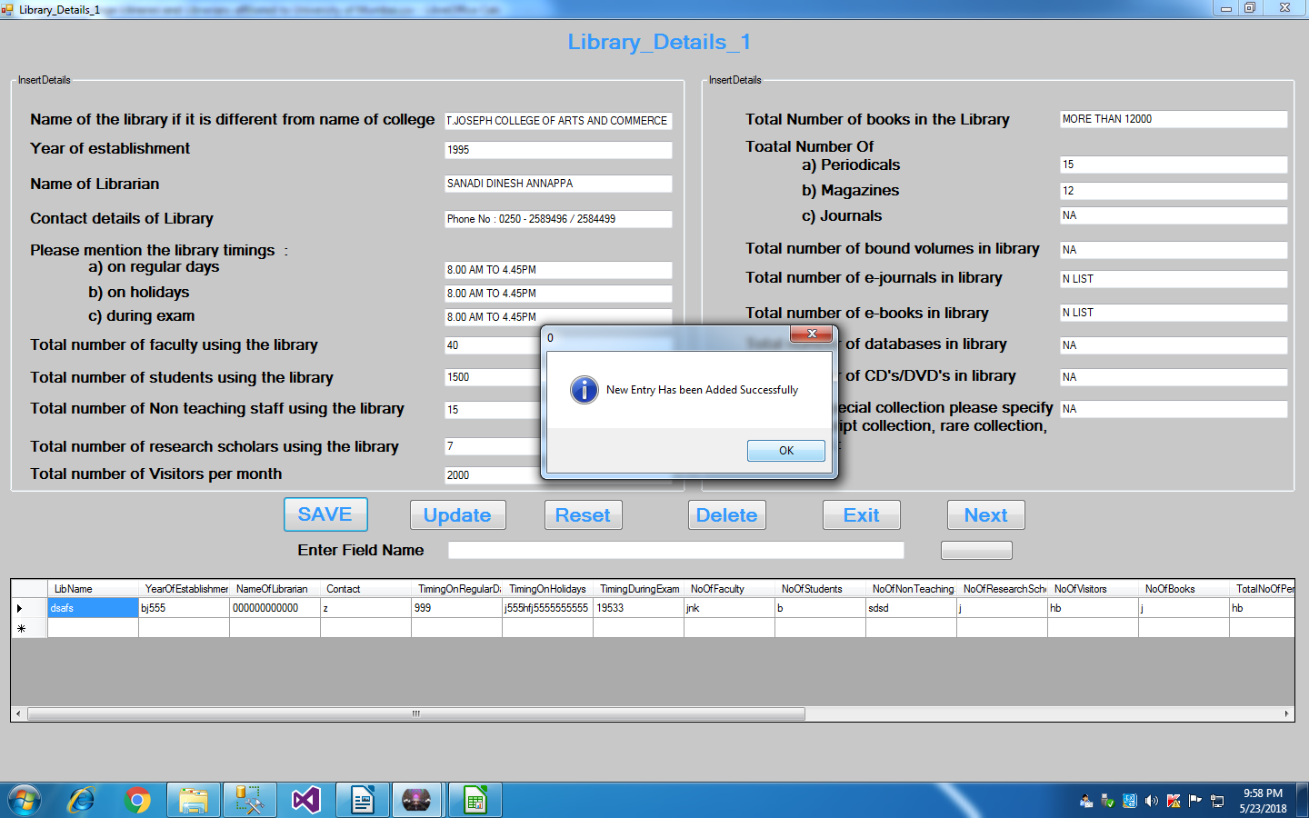
1) Save:

Slide 16
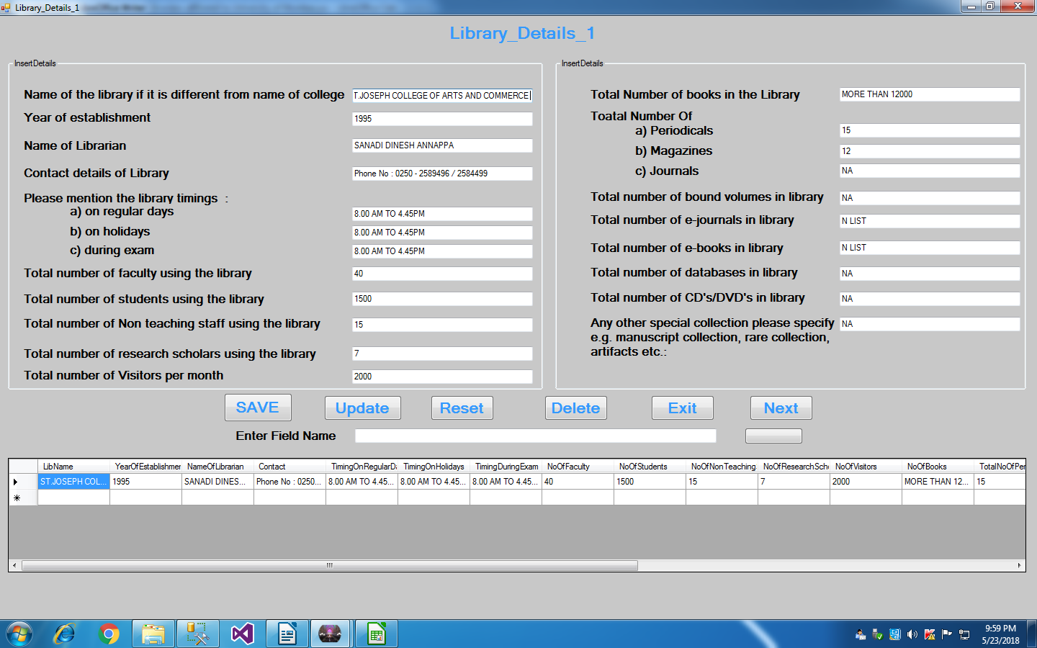

Slide 17
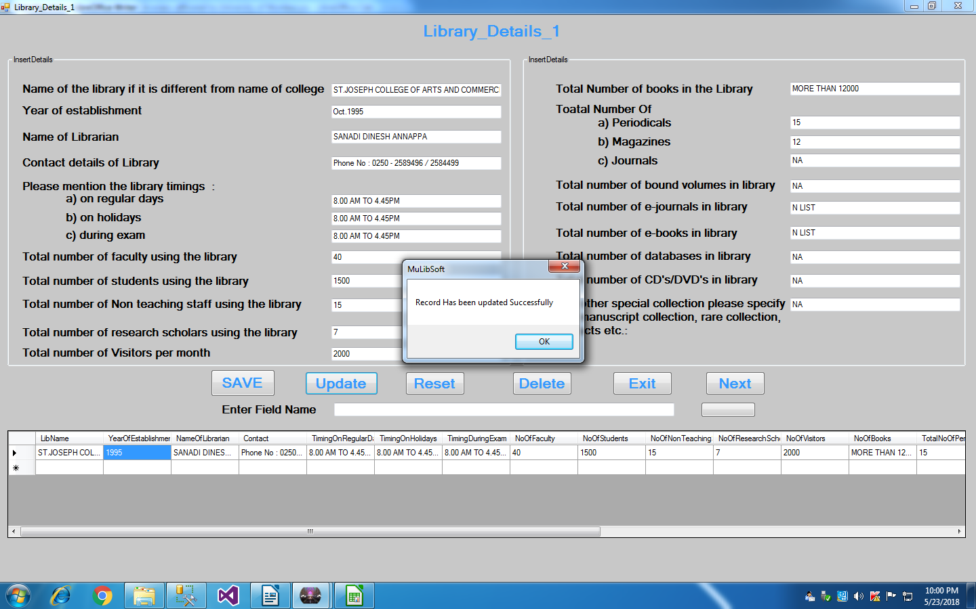
2) Update:

Slide 18
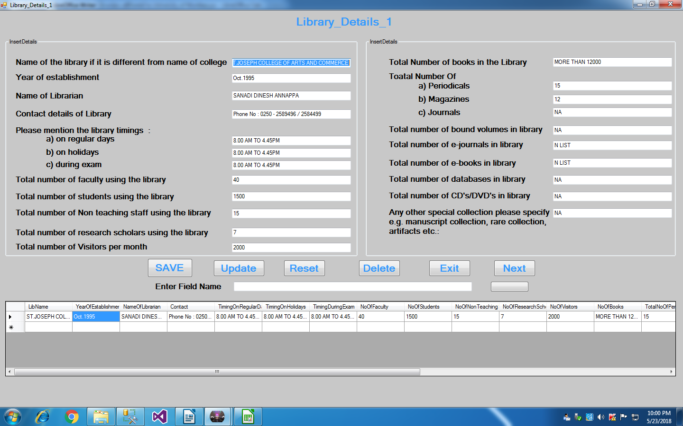

Slide 19
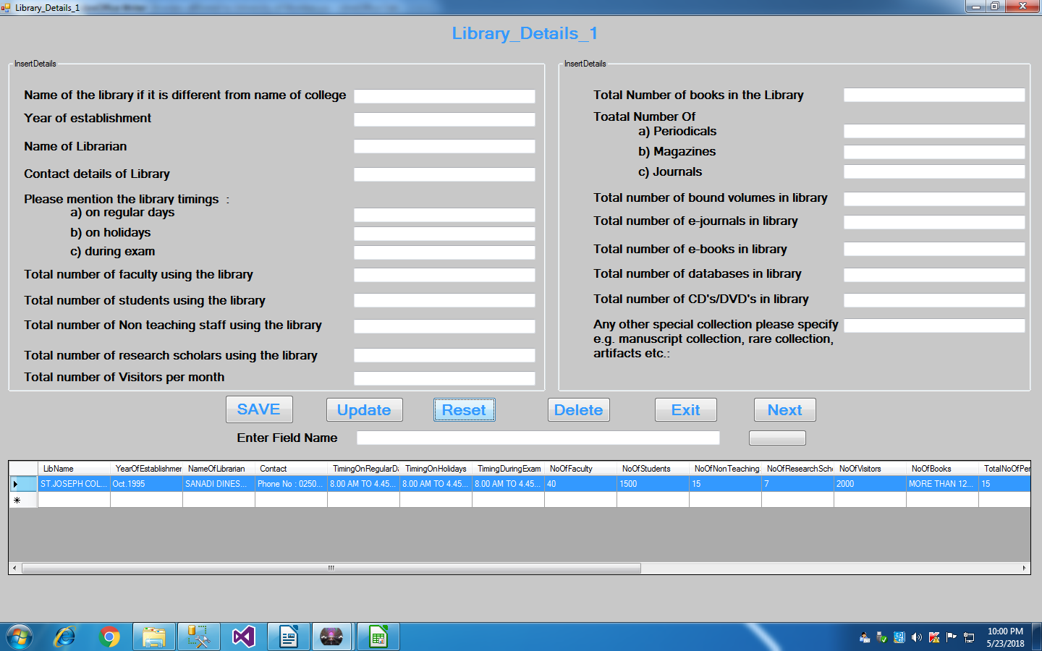
3) Reset:

Slide 20
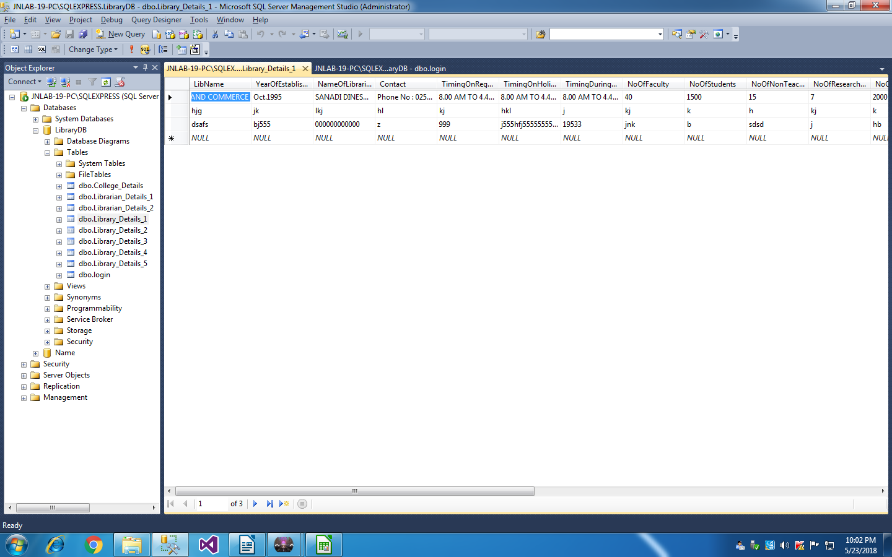
4) Delete:

Slide 21
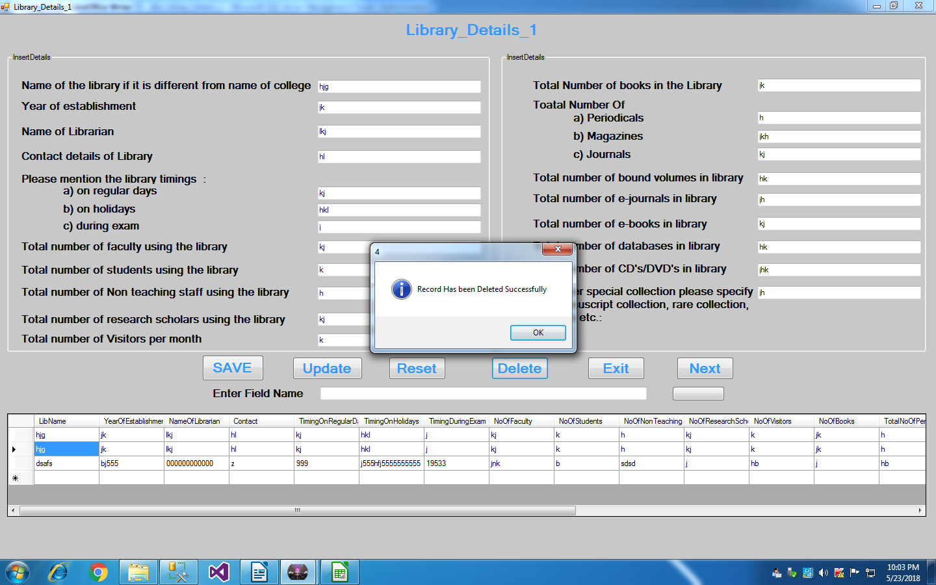

Slide 22


Slide 23
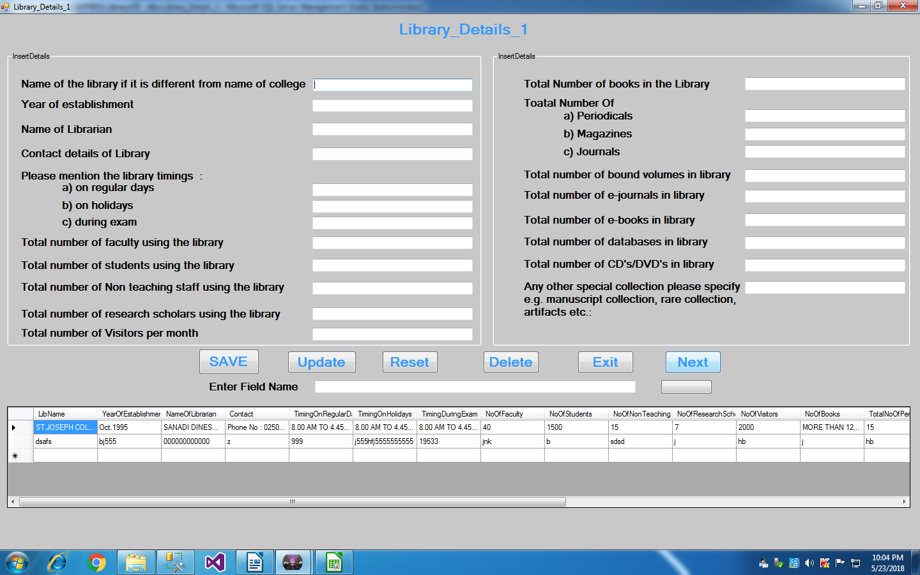
5) Next:

Slide 24
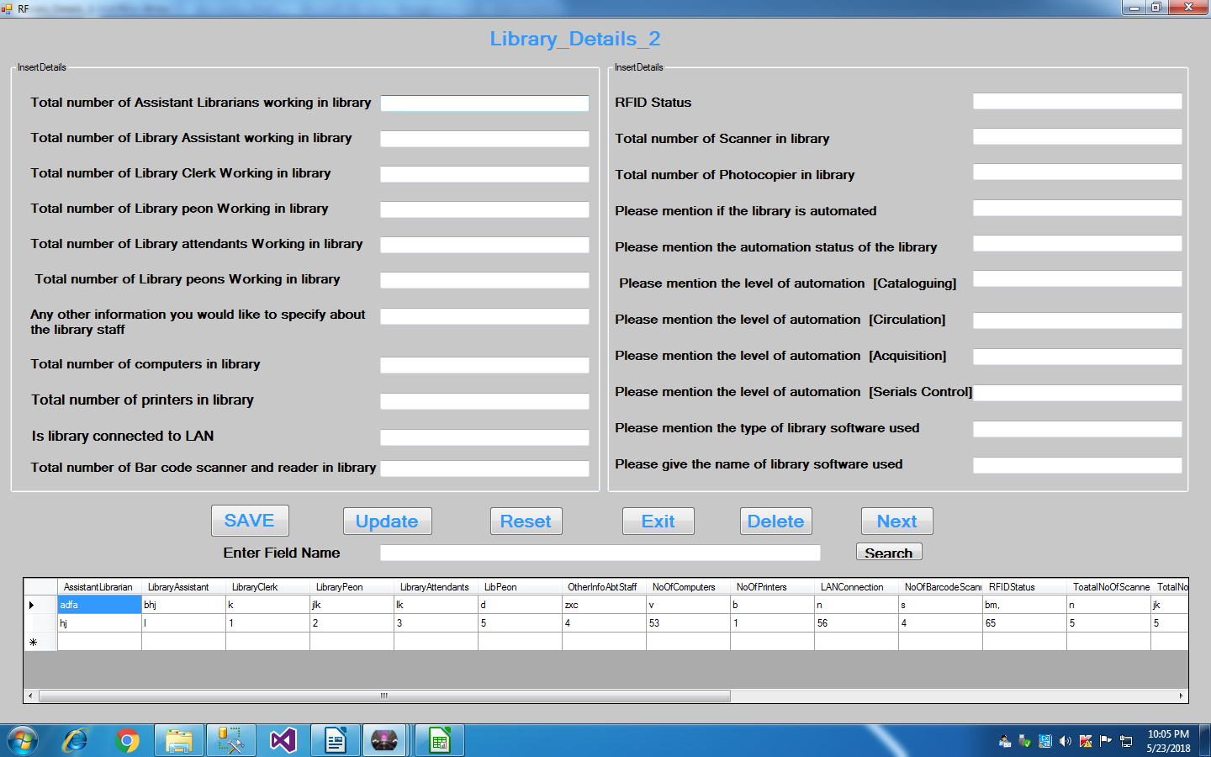

Slide 25

6) Exit:

Slide 26
Inference:
Successfully created the College Libraries Directory Management System Desktop Application.
Now it is ready to use and insert new records in the database.
It is very easy to access the added records in database to update, delete.
Backup of database can be created at any point of time through this model.

Slide 27
Thank You…

